Slide 1
EDA on
Layoffs In Company
Presented By: Janani Jennifer

Slide 2
Agenda
Introduction
System Design
Implementation
Conclusion

Slide 3

Introduction
Layoffs happen when a company decides to let go of some of its employees

Slide 4
EDA on Layoffs In Company
The EDA consists of 12 columns. Here we have 12 features using this we start data analysis of LAYOFFS in company
This data set consists of information: .
Company
Location_HQ
Industry
Percentage
Date
Source
Funds_Raised
Stage
Date_Added
Country
Laid_Off_Count
List_of_Employees_Laid_Off

Slide 5
SYSTEM DESIGN
Business
Understanding
Data
collection
Data
Preprocessing
Data Visualization
Descriptive analysis
Data cleaning

Slide 6
IMPLEMENTATION
Required Libraries to be imported :
import numpy as np
import pandas as pd
import seaborn as sns
import matplotlib.pyplot as plt

Slide 7

Data Preprocessing
Loading Data:
df=pd.read_csv("G:\datascience\layoffs_data.csv")
Shape Of Dataframe
df.shape
o\p
(2738, 14)

Slide 8

Data cleaning
Checking for missing values
#code
df.isnull().sum()
Company 0
Location_HQ 0
Industry 0
Percentage 919
Date 0
Source 0
Funds_Raised 272
Stage 0
Date_Added 0
Country 0
Laid_Off_Count 867
List_of_Employees_Laid_Off 1

Slide 9


After replacing the null value with the mean value of that column
01
02
df['Percentage'].mean()
Company 0
Location_HQ 0
Industry 0
Percentage 0
Date 0
Source 0
Funds_Raised 272
Stage 0
Date_Added 0
Country 0
Laid_Off_Count 867
List_of_Employees_Laid_Off 1
0.26528174821330025

Slide 10

After replacing the null value with the mean value of that column
df['Funds_Raised'].mean()
805.9941182076236
Company 0
Location_HQ 0
Industry 0
Percentage 0
Date 0
Source 0
Funds_Raised 0
Stage 0
Date_Added 0
Country 0
Laid_Off_Count 867
List_of_Employees_Laid_Off 1

Slide 11
After replacing the null value with the mean value of that column
df['Laid_Off_Count'].mean()
252.40566541956173
Company 0
Location_HQ 0
Industry 0
Percentage 0
Date 0
Source 0
Funds_Raised 0
Stage 0
Date_Added 0
Country 0
Laid_Off_Count 0
List_of_Employees_Laid_Off 1

Slide 12
As there is only one missing value
we can fill it by ‘Unknown’
df['List_of_Employees_Laid_Off']=df['List_of_Employees_Laid_Off'].fillna('unknown')
Company 0
Location_HQ 0
Industry 0
Percentage 0
Date 0
Source 0
Funds_Raised 0
Stage 0
Date_Added 0
Country 0
Laid_Off_Count 0
List_of_Employees_Laid_Off 0

Slide 13

End of Data Preprocessing

Slide 14

EXPLORATORY DATA ANALYSIS

Slide 15
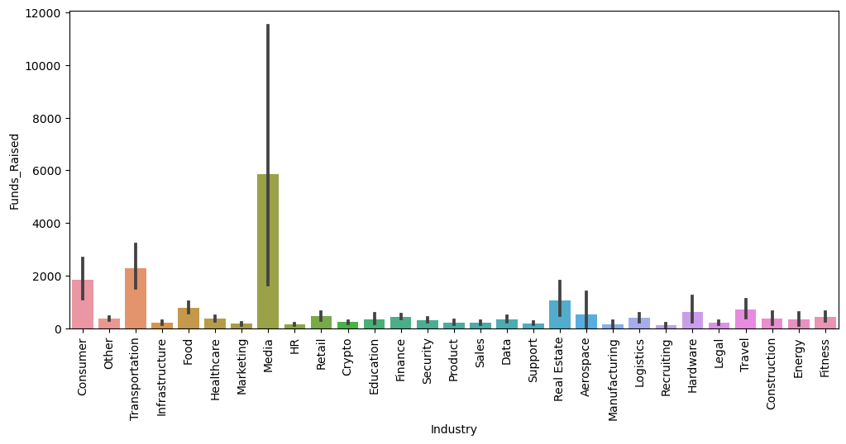
Q1.
Industries That have raised the highest Funds

Slide 16

Media Industry has raised the highest funds

Slide 17
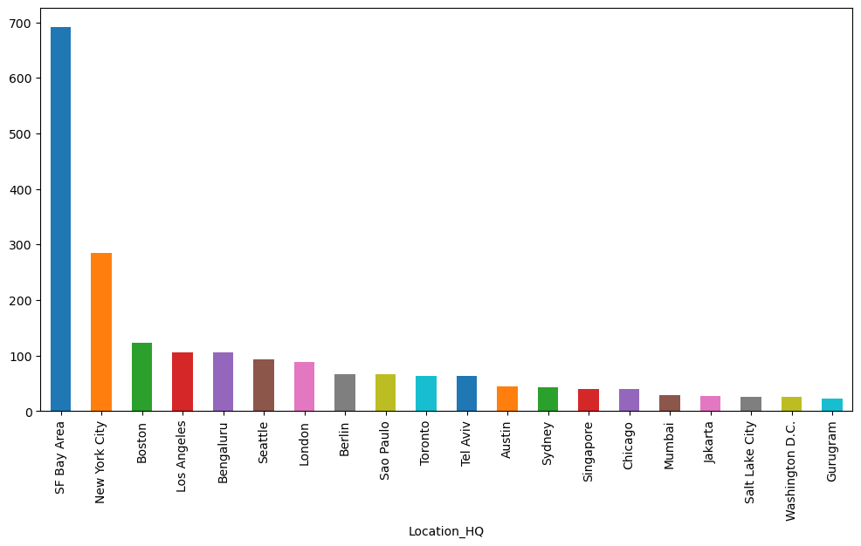
Q2.
In which country there are most head quarters

Slide 18
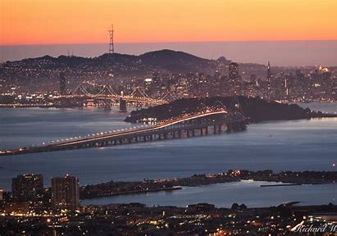
San Francisco Bay Area has the highest Head Quarters

Slide 19
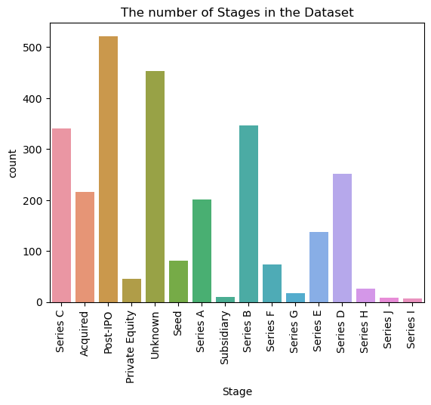
Q3.
what are the Types of stages in the dataset?

Slide 20

Post -IPO is highest stage in the dataset
IPO stands for Initial Public Offering

Slide 21
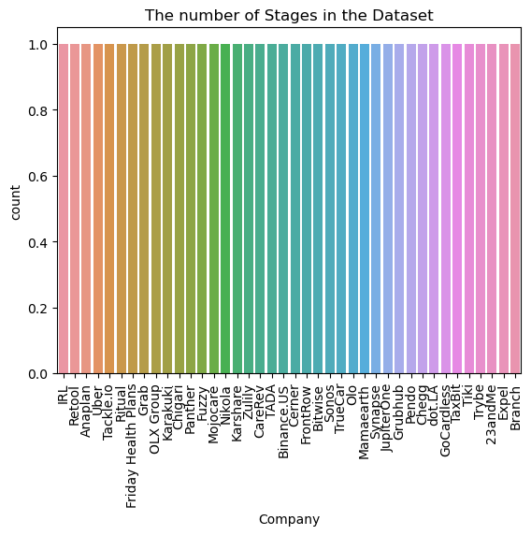
Q4.
what are the company stages in the dataset?

Slide 22
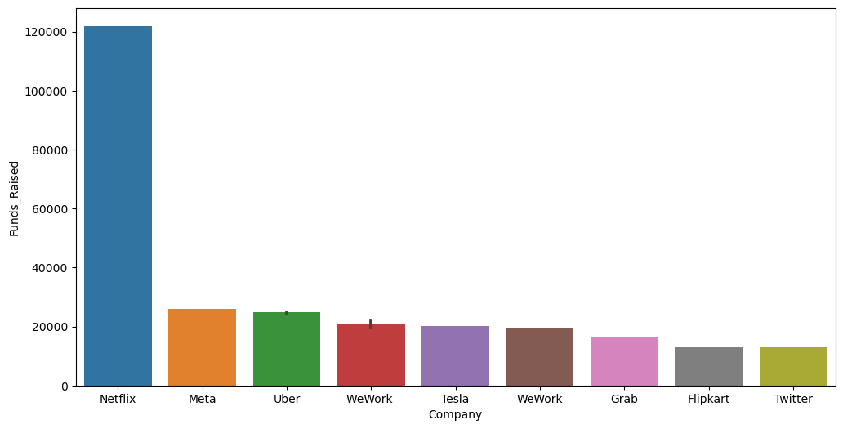

Q5.
which are the largest fund raised company?

Slide 23

Netflix is the highest fund raised company

Slide 24
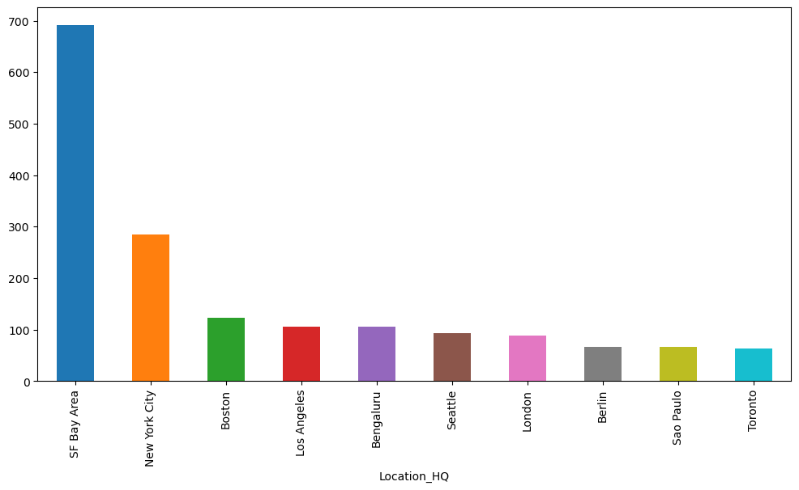
Q6.
what are the top 10 Funds Raised company loaction

Slide 25
San Francisco Bay Area has the highest fund raised

Slide 26
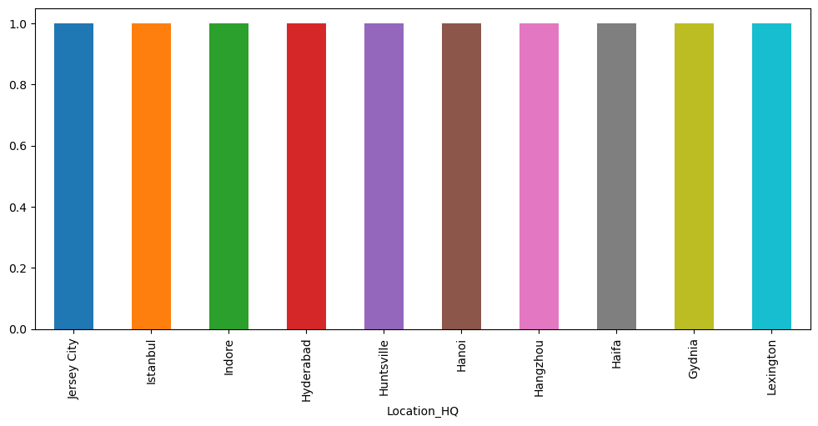
Q7.
What are the least 10 head quarters located cities?

Slide 27
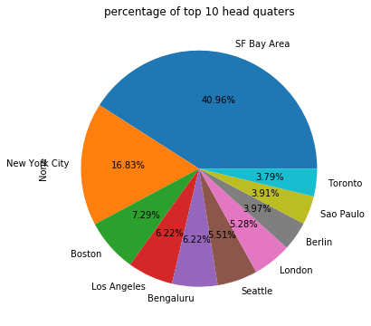
Q8.
What is the percentage of top 10 head quarters?

Slide 28


We can observe from the pie chart that
The highest percentage of the Head Quarter is San Francisco Bay Area
The lowest percentage of the Head Quarter is Toronto

Slide 29
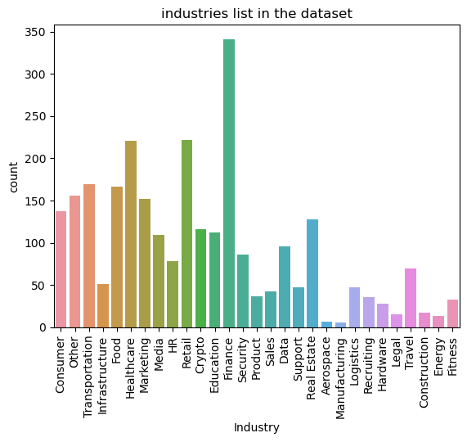
Q9.
Some of the industries present in dataset.

Slide 30


Finance industry is the highest industry
Manufacturing is the lowest industry

Slide 31
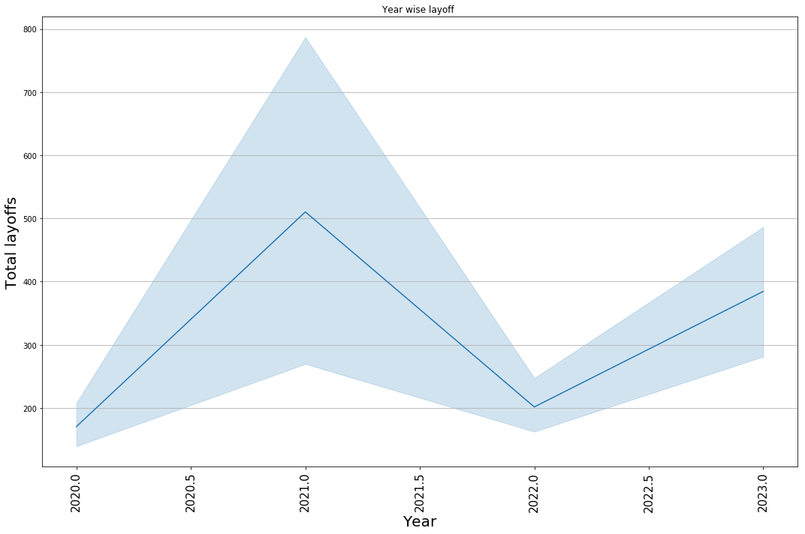
10.
Let us check the year wise Layoffs

Slide 32
THE HIGHEST LAYOFFS WERE IN THE YEAR OF 2020
 | Year | Laid_Off_Count
0 | 2020 | 80998.0
1 | 2021 | 15823.0
2 | 2022 | 164709.0
3 | 2023 | 210721.0

Slide 33
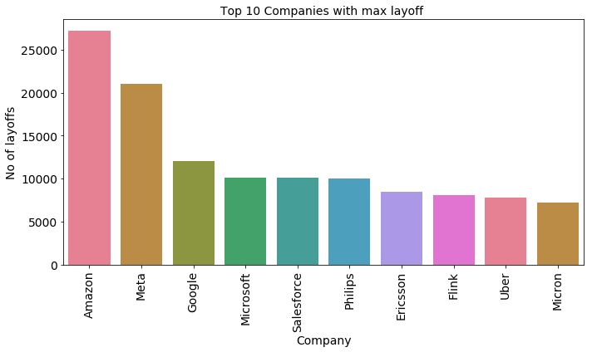
Q11.
Top 10 companies with maximum layoffs

Slide 34

Amazon has the highest Layoffs

Slide 35
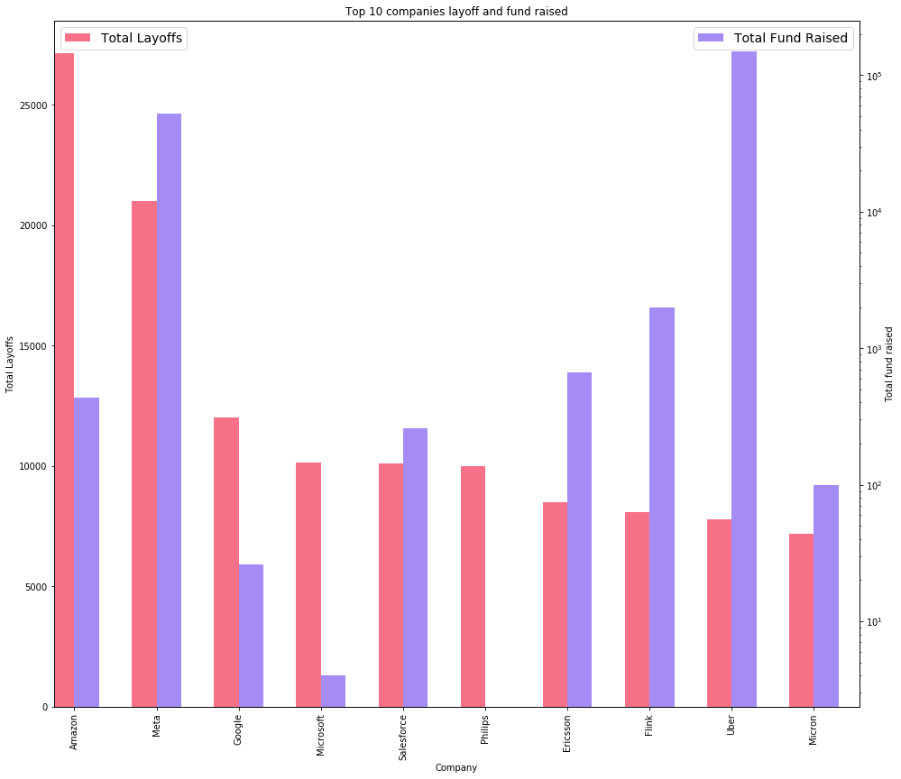
Q12.
Relationship B\W Funds received and Layoffs

Slide 36

We can observe that:
As the Amazon has the highest Layoffs but its funds are not raised
As the Uber company has the highest Funds raised but its Layoffs are not high

Slide 37
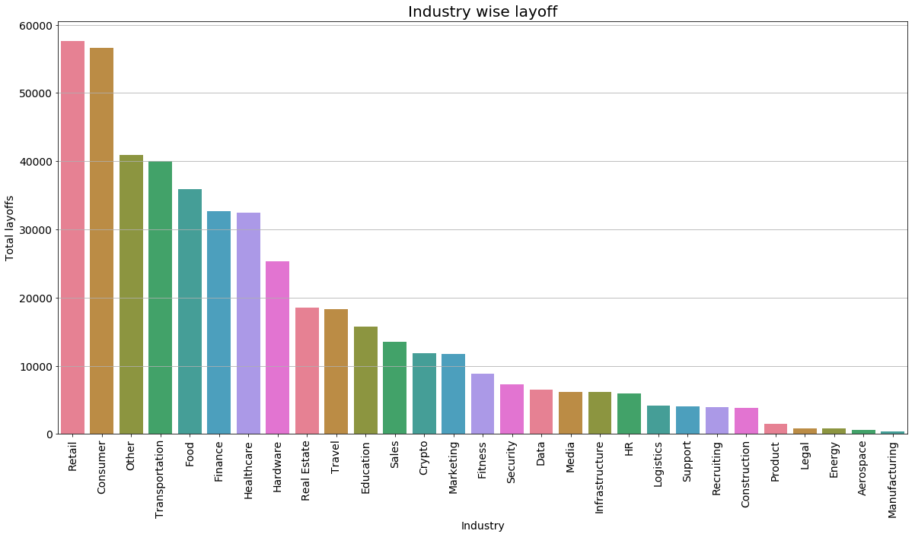
Q13.
Industry wise Layoffs

Slide 38
We can observe that:
Highest Layoffs are in the retail industry
Lowest Layoffs are in the Manufacturing Industry

Slide 39
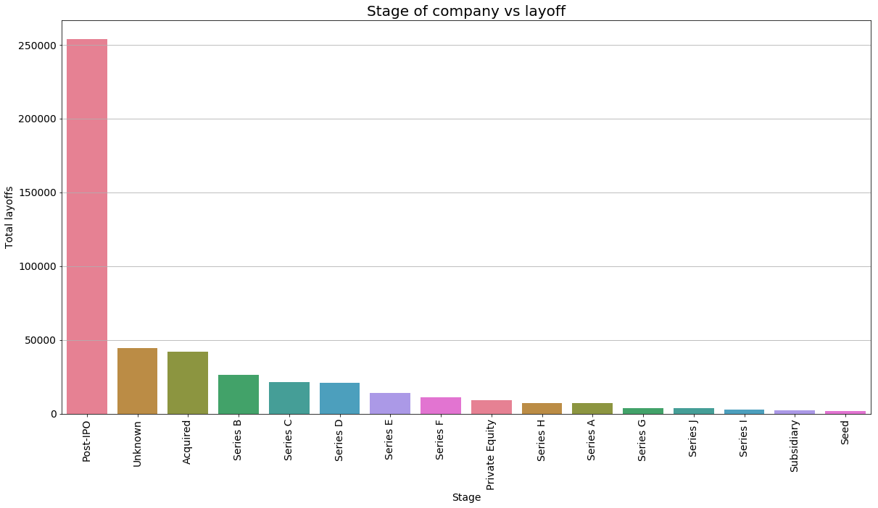
Q13.
In which stage of company had the most Layoffs

Slide 40
We can observe that:
Highest Layoffs are in the Post-IPO stage
Lowest Layoffs are in the Seed Stage

Slide 41
CONCLUSION
Post -IPO is highest stage in the dataset
Netflix is the highest fund raised company
San Francisco Bay Area has the highest fund raised
The highest percentage of the Head Quarter is San Francisco Bay Area The lowest percentage of the Head Quarter is Toronto
Finance industry is the highest industry
Manufacturing is the lowest industry
The highest Layoffs were in the year of 2020
As the Amazon has the highest Layoffs but its funds are not raised
As the Uber company has the highest Funds raised but its Layoffs are not high
Media Industry has raised the highest funds

Slide 42

Thank You

